Slide 2
Final Variables
If you don't want others (or yourself) to overwrite existing values, use the final keyword (this will declare the variable as "final" or "constant", which means unchangeable and read-only)
final int myNum = 15;
myNum = 20; // will generate an error: cannot assign a value to a final variable

Slide 3
class Final_Var
{
public static void main(String args[])
{
final int a= 20;
a=22;
}
}

Slide 4
How to display variables?
class Display_var
{
public static void main(String args[])
{
String fName = "SIT ";
String lName = "College";
//Concatenates two variables
String fullName = fName+ lName; System.out.println(fullName);
int x = 5;
int y = 6;
// Print the value of x + y
System.out.println(x + y);
//Declare Many Variables
int a=66,b=45,c=6;
System.out.println(a+b+c);
}//end of main
}//end pf class

Slide 5
Java Identifiers
All Java variables must be identified with unique names.
These unique names are called identifiers.
The general rules for naming variables are:
Names can contain letters, digits, underscores, and dollar signs
Names must begin with a letter
Names should start with a lowercase letter, and cannot contain whitespace
Names can also begin with $ and _
Names are case-sensitive ("myVar" and "myvar" are different variables)
Reserved words (like Java keywords, such as int or boolean) cannot be used as names

Slide 6
// Student data
String studentName = “Rakesh Deo";
int studentID = 15;
int studentAge = 23;
float studentFee = 75.25f;
char studentGrade = 'B';
// Print variables
System.out.println("Student name: " + studentName);
System.out.println("Student id: " + studentID);
System.out.println("Student age: " + studentAge);
System.out.println("Student fee: " + studentFee);
System.out.println("Student grade: " + studentGrade);

Slide 7
Calculate the Area of a Rectangle
// Create integer variables
int length = 4;
int width = 6;
int area;
// Calculate the area of a rectangle
area = length * width;
// Print variables
System.out.println("Length is: " + length);
System.out.println("Width is: " + width);
System.out.println("Area of the rectangle is: " + area);

Slide 8
Java Type Casting
Type casting is when you assign a value of one primitive data type to another type.
Widening Casting (automatically) - converting a smaller type to a larger type size.
Narrowing Casting (manually) - converting a larger type to a smaller size type.

Slide 9
Widening Casting
public class TCast {
public static void main(String[] args) {
int myInt = 9;
double myDouble = myInt; // Automatic casting: int to double
System.out.println(myInt); // Outputs 9
System.out.println(myDouble); // Outputs 9.0
}
}

Slide 10
Narrowing Casting
public class Ncast {
public static void main(String[] args) {
double myDouble = 9.78d;
int myInt = (int) myDouble; // Manual casting: double to int
System.out.println(myDouble); // Outputs 9.78
System.out.println(myInt); // Outputs 9
}

Slide 11
Java Operators
Java Operators
Operators are used to perform operations on variables and values.
Java divides the operators into the following groups:
Arithmetic operators
Assignment operators
Comparison operators
Logical operators
Bitwise operators

Slide 12
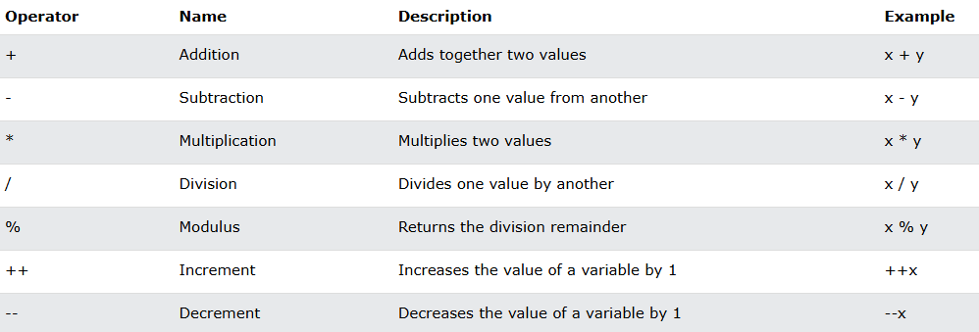
Arithmetic operators

Slide 13
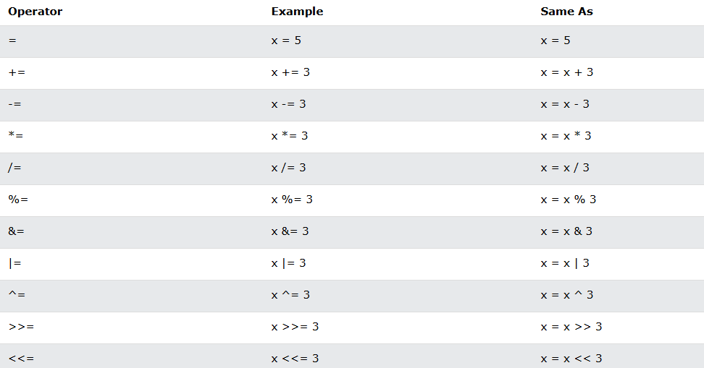
Assignment operators

Slide 14
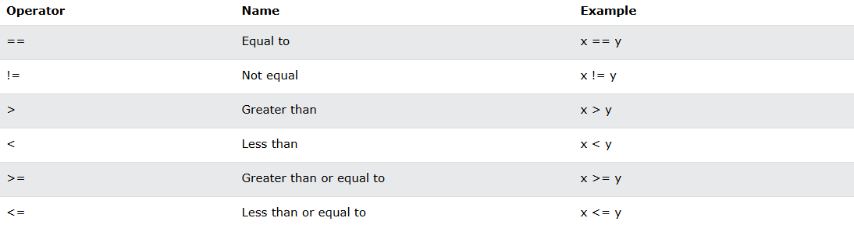
Comparison operators
This is important in programming, because it helps us to find answers and make decisions. The return value of a comparison is either true or false. These values are known as Boolean values.

Slide 15
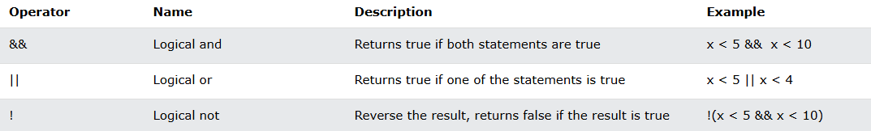
Logical operators

Slide 16
Bitwise operators

